Slide 1
Design Patterns
Structural Design Patterns

Slide 2
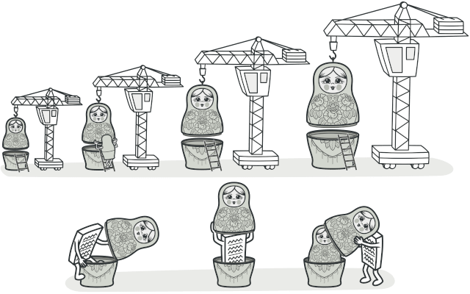
Decorator Pattern
Decorator is a structural design pattern that lets you attach new behaviors to objects by placing these objects inside special wrapper objects that contain the behaviors.
https://www.youtube.com/watch?v=iUZZ8aBYYtE
Notes:
Text or Graphical decorations (adding extra components to the objects at run time without affecting the base class)

Slide 3
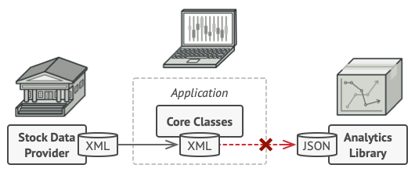
Adapter Pattern
Imagine that you’re creating a stock market monitoring app. The app downloads the stock data from multiple sources in XML format and then displays nice-looking charts and diagrams for the user.
At some point, you decide to improve the app by integrating a smart 3rd-party analytics library. But there’s a catch: the analytics library only works with data in JSON format
https://www.youtube.com/watch?v=HiFOmujCE8c

Slide 4
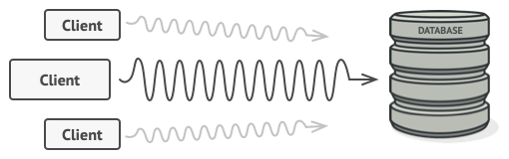
The Proxy Pattern
You have a massive object that consumes a vast amount of system resources. You need it from time to time, but not always.
Lazy Implementation: Create this object only when its actually needed. Allow clients to defer initialization until needed but with lots of code duplication.
3rd party code cant be embedded in your client.
https://www.youtube.com/watch?v=IsphOfVNWCc

Slide 5
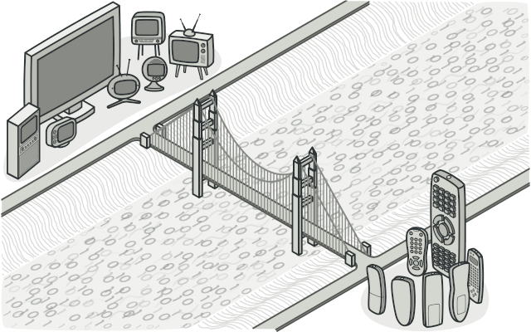
The Bridge Pattern
Bridge is a structural design pattern that lets you split a large class or a set of closely related classes into two separate hierarchies—abstraction and implementation—which can be developed independently of each other.

Slide 6
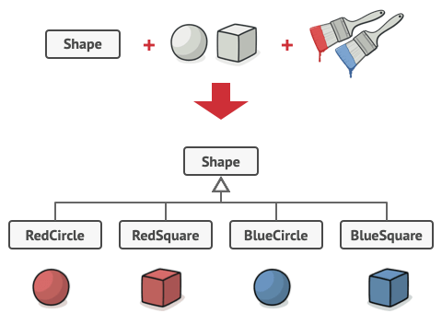
Problem
Class: Shape
Subclasses: Circle and Square
Want to add Colour so you create BlueCircle and RedSquare.
This can go on Exponentially!
Trying to extend the shape classes in two independent dimensions: by form and by color. That’s a very common issue with class inheritance.

Slide 7
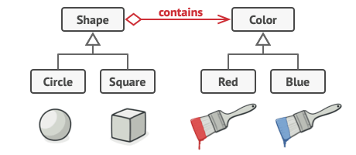
Solution
Switch from Inheritance to object composition
Create a new Colour Object
Link to that Colour Object
Delegate Colour related work to the Colour Object

Slide 8
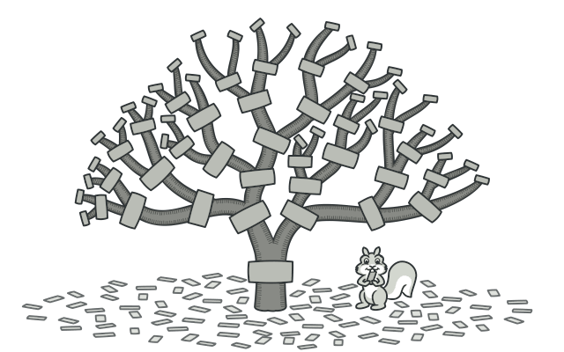
The Composite Pattern
Compose objects into tree structures and work with these structures like they are individual objects

Slide 9
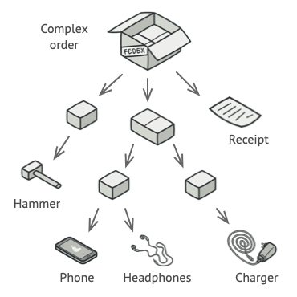
Problem
Complex Order
Packages
Other Packages
Items
You Want
Item Count
Total Cost of Good
Solution
Unpack Everything
Loop Over Items and Count

Slide 10
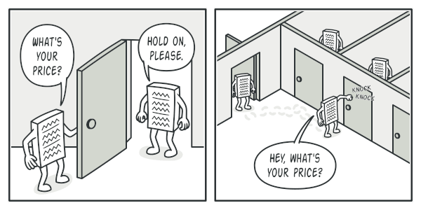
Solution
Common Interface
- Declare Method for:
- Item Count
- Total Price
- Allows for Recursive calculations

Slide 11
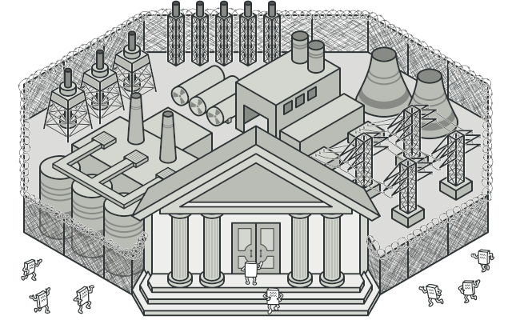
The Facade Pattern
A façade is a class that provides a simple interface to a complex subsystem with lots of moving parts
https://youtube.com/clip/UgkxC1eEQnFnlNsH6P5BQBcc8FLq4Siacpz_?si=YWjvbDJOZwwnpqQW

Slide 12
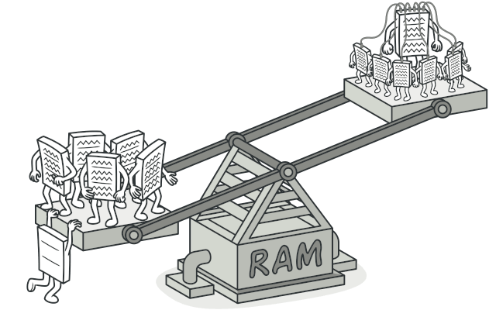
The Flyweight Pattern
Optimization Pattern – Reduce RAM
Split State
Intrinsic – Constant Data About the Object
Extrinsic – Aspects of the Object Affected By the Outside
https://youtu.be/RDV0ioVTF4g?si=oUXGAUEXSIBwuuSd
https://www.youtube.com/watch?v=8cL9KbHS5kE

